Slide 1
AI in Medical Imaging
By: Pradyoth Singenahalli Prabhu
02071847

Slide 2
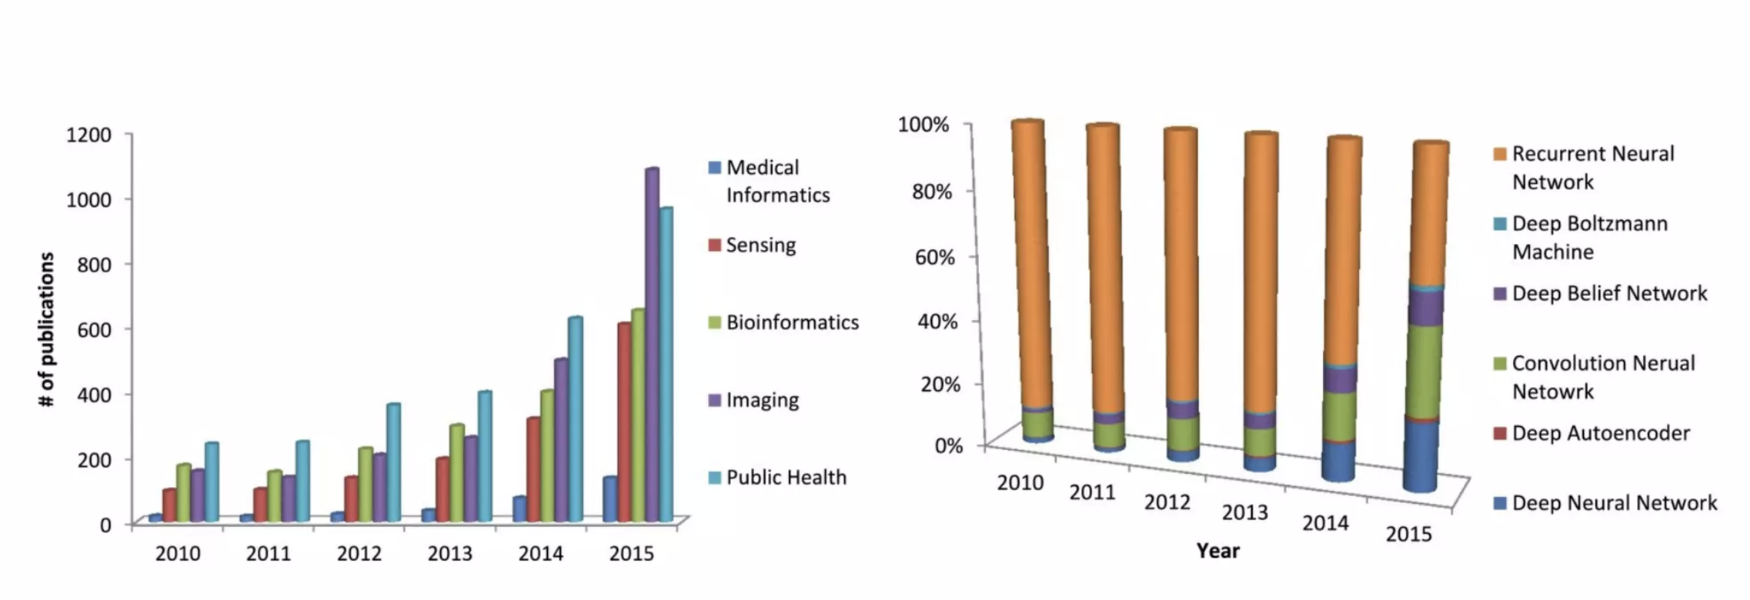
MI: Deep learning Activity
Litjens et al, A Survey on Deep Learning in Medical Image Analysis, June 2017

Slide 3
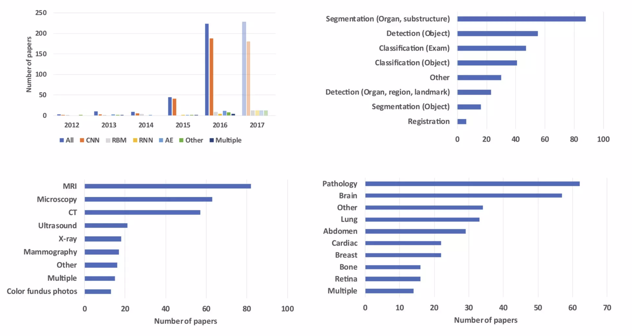
Medical Imaging: Publication

Slide 4
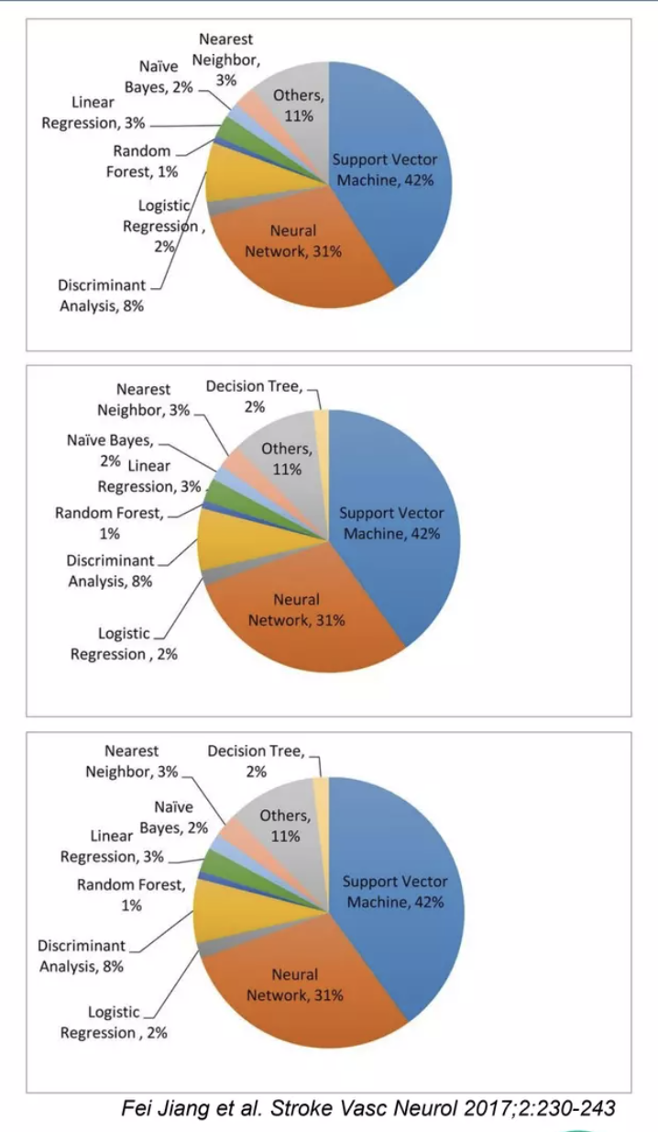
Medical imaging & Al: the roots
﻿﻿1956. First Al conference at Durtmouth College
﻿﻿John McCarthy coined the term "Artificial Intelligence"
﻿﻿1956-1974. First golden years, Cold War era
﻿﻿Translation Russian into English
﻿﻿1972. MYCIN expert system (LISP)
﻿﻿to assist physicians in the diagnosis of infectious diseases
﻿﻿1974 - 1980. First Al winter. Disillusionment. Could not solve practical problems
ALPAC and Lighthill reports, loss of research funding in USA and UK
﻿﻿1980 - 1987. Designed by humans.
﻿﻿Sequential application of low-level pixel processing and mathematical modeling
﻿﻿1987 - 1993. Second Al winter. Could not teach expert's knowledge
﻿﻿Transition between specific LISP machine (failure) to general purpose computers
﻿﻿1996. DeepBlue. Man vs Machine, Chess (512 Core)
﻿﻿the fastest computer to face a world chess champion
﻿﻿At the end of the 1990s. Trained by computer. Crucial step-handcrafted features
﻿﻿Supervised techniques, where training data is used to develop MIA systems.
The basis of many successful commercially available medical image analysis systems.
﻿﻿Segmentation based on vector extraction; Atlas as a optimal decision boudaries
﻿﻿2011. DeepQA. Man vs Machine, Jeopardy(2 880 Core - Millions books of data)
﻿﻿computer system capable of answering questions posed in natural language
﻿﻿2012, AlexNet won ImageNet challenge (16 000 Core -10 Millions images)
﻿﻿Recognition of Convolutional Neural Network as technique of choice
Litjens et al, A Survey on Deep Learning in Medical Image Analysis, June 2017
N Mehta, M. V. Devarakonda, Machine learning, natural language programming, and electronic health records: The next step in the artificial intelligence journey?, J Allergy Clin Immunol, June 2018

Slide 5
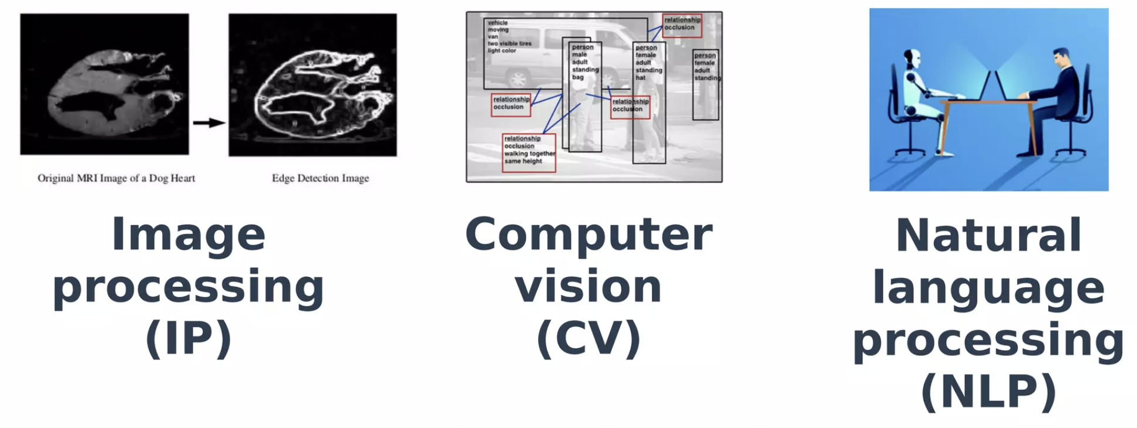
MIA & Al: Augmented Medical Imaging
Machine Learning
Diagnosis is now more efficient and accurate

Slide 6
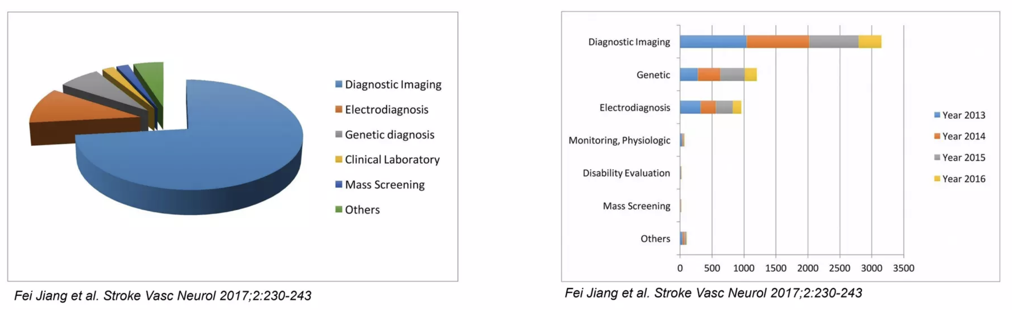
MI & Al: actual context
﻿﻿Radiology pioneering work
Medical imaging perception since 1980s.
Radiologists are domain experts
Medical imaging, medical physics and radiation safety.
Image substantial innovations
In the past 5-10 years, new innovations in imaging from deep learning methods of image classification.
Accuracy rates vs human
Current artificial neural networks have accuracy rates which surpass those of human radiologists in narrow-basedtasks such as nodule detection.
Ch Liew, The future of radiology augmented with Artificial Intelligence: A strategy for success, European Journal of Radiology 102 (2018)

Slide 7
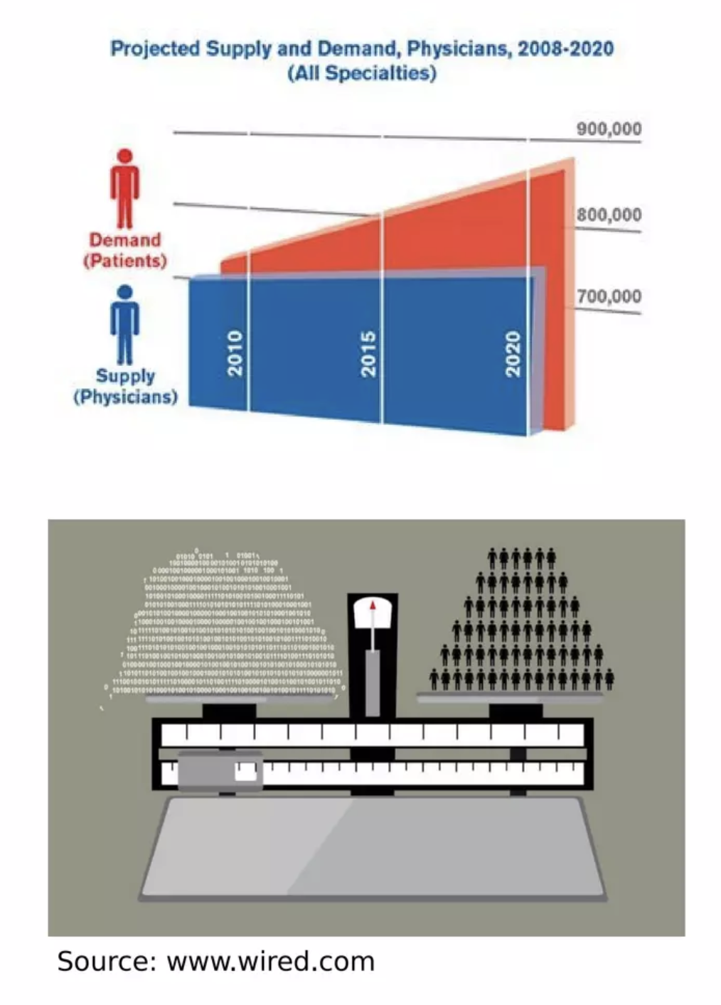
Radiology & Al: impacts
﻿Shortage of specialist: detection and prediction automation
﻿﻿To automate detection nodules in CT scans and pneumonia on chest x-rays
﻿﻿To predict the behavior of pre-cancerous lesions to reduce the number of unnecessary invasive tests such biopsy
﻿﻿Screening for cancer
﻿﻿Accuracy diagnosis: intelligence augmentation
Hybrid intelligence: higher levels of accuracy in diagnosis
﻿﻿Precision medicine: precision diagnostics and big data
﻿﻿To mine huge data to link gene expression to imaging features
﻿﻿Genetic and imaging biomaker correlation
﻿﻿Assisted agent: radiological decision support systems
﻿﻿Imaging studies have increased over the last two decades, almost doubling every ten years
﻿﻿Reduce information overload and burnout (Radiologist interpret one image 3-4s.)
﻿﻿Aid of rapid detection of emergency condition
Ch Liew, The future of radiology augmented with Artificial Intelligence: A strategy for success, European Journal of Radiology 102 (2018) 152-156

Slide 8
Radiology & Al: implementation
Automated image segmentation
﻿﻿Lesion detection
﻿﻿Measurement
﻿﻿Labelling
﻿﻿Historical comparaison
Generating reports
﻿﻿NL processing
﻿﻿NL generation
﻿﻿Image classification
Semantic error detection
NLP agents as a second reader to warn about semantic errors
Data mining for research
NLP to build searchable databases
Business intelligence
Real-time dashboards
﻿﻿Alert systems
﻿﻿Workflow analysis
﻿﻿Performance assessment
Emergent disciplines
﻿﻿ omics

Slide 9
Medical Imaging & Al: challenges
Security
Al system must be validated to be safe, accurate and infallible before it can be used on patients.
Failure & Judicial transparency
Al system must be auditable, not black-box algorithms
Privacy
Al systems should have access only to relevant personal health information.
Al systems and companies must be auditable and to ensure compliance within the framework of patient consent.
Ch Liew, The future of radiology augmented with Artificial Intelligence: A strategy for success, European Journal of Radiology 102 (2018) 152-156

Slide 10
Thank You

